Slide 1
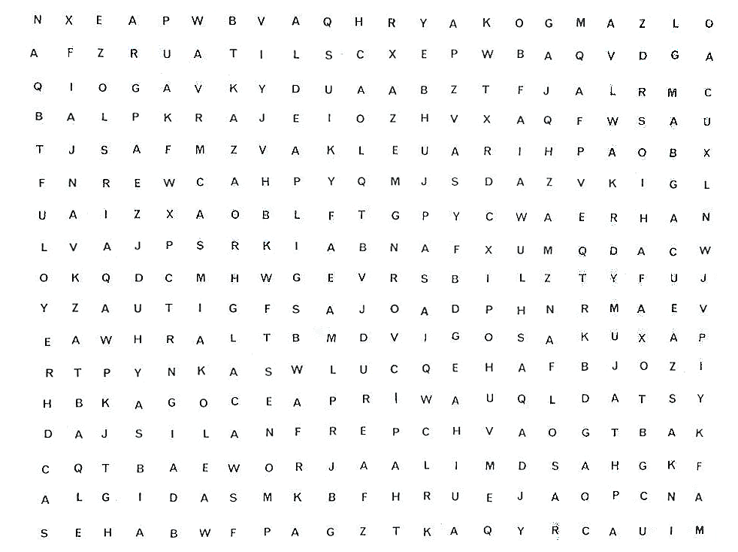
In the following task you are going to be presented with a series of letters in columns and rows, like in the example below.
Your task is to simply count aloud the number of A’s you can find. So in the example below, there are 7 A’s, 2 in the first row, 2 in the second row, 3 in the third row and none in the fourth row.
When the next slide appears, start at the top left hand corner and work across and down as if you were reading a book. Simply count aloud as you find each A.
Work as quickly as you can. The slide will not be visible for all that long.

Slide 3
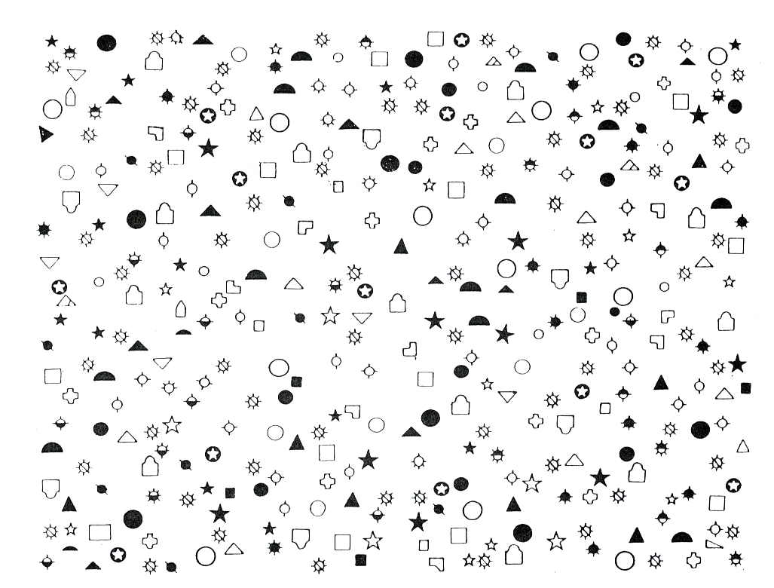
The next trial is much the same as before only the stimuli are symbols. However, your task is still the same, you have to count aloud the number of symbols on the slide. The symbol you are looking for is:
When the next slide appears, simply count aloud as you find each symbol.
Work as quickly as you can. The slide will not be visible for all that long.

Slide 5
This part of the experiment has finished

