Slide 1
Flavour Threshold testing How Salty
Notes:
Good morning everyone and welcome to this Future Talk entitled “Food for Thought. I’m Polly Burey, and I am based in the School of Agricultural, Computational and Environmental Sciences where I’m the Senior Lecturer in Food Science.
Today I’m going to discuss what food science is, and why we need it into the future. – 20 seconds

Slide 2
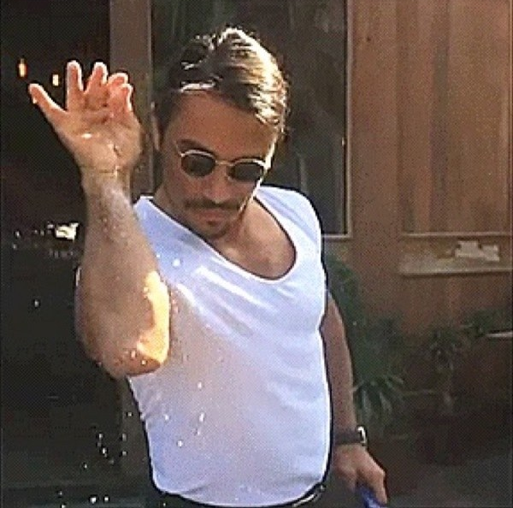
What is taste/flavour threshold testing?
Tests to determine at which flavour concentration the majority of people can correctly identify the presence of the flavour
We are going to use salt as our basis today.
There are a series of samples of different concentration from low to high.
You will need to put them in order!
This can be done with any flavour and ‘matrix’

Slide 3
Instructions
You have 5 samples in random order which have been placed in front of you.
First take a sip of water to clear your palate and taste the first sample on the left. Evaluate how salty it is.
Take another sip of water and taste the second sample. Determine whether it is saltier or less salty than the first sample.
Continue testing the samples in order from left to right taking sips of water between tastings and placing them in order from least salty to most salty. Write down in order the 3 digit sample code
NO TALKING!!
We will chat when everyone is done.

Slide 4
How to set this up in your own class
In research papers threshold testing is done on a molar basis
For salt (NaCl), 1 mol = 58 grams
In this exercise I first made up a concentrated solution and from that made 100 mM, 50 mM, 25 mM, 12.5 mM and 6.25 mM, 3.125 mM and 1.5625 mM solutions. I also had one pure water sample
To make up the concentrated solution I weighed out 1.16 grams of salt in a beaker (or measuring jug is fine) and added water up to the 200 mL mark. This made a 100 mM solution.
From that I made dilutions to the other concentrations by doing 1:1 ratios in sequence.

Slide 5
Order of saltiness?

Slide 6
Thank you!
Polly.Burey@usq.edu.au
07 4631 1937
usq.edu.au

